Slide 1
Preprocessing Differential Expression Analysis Following Environmental Stressors
Joan Zhang
Emily Wilkins
Collin Modelski

Slide 2
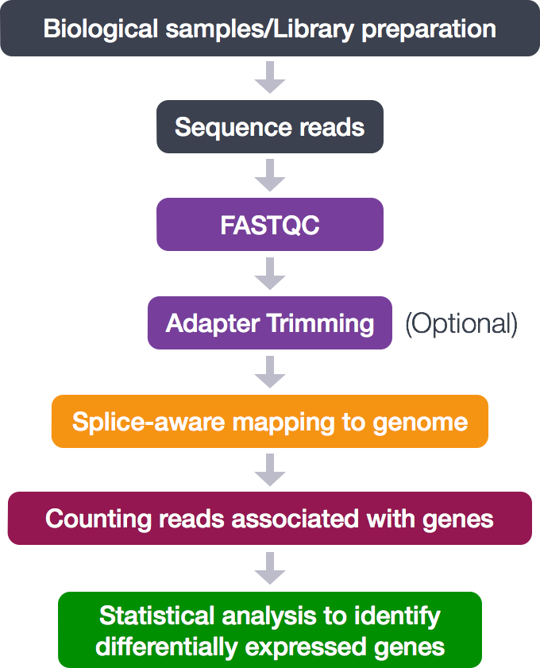
What is RNA-Seq Data?
Next generation sequencing
Primarily used to identify transcriptome wide differential gene expression (DEG)
Provides higher coverage of the transcriptome
Can determine:
Novel transcripts
Alternative splice variants
Single nucleotide polymorphisms (SNPs)
Insertions and/or deletions

Slide 3

Data Used for Analysis
Data for this project originated from the paper: “Granzyme B prevents aberrant IL-17 production and intestinal pathogenicity in CD4+ T cell”
Hoek et al. 2021
Many factors involved in activation of T cells
Hypothesized that granzyme B is is readily expressed by certain T cells and leads to differentiation - specifically in lymphatic tissue
Cultured naive CD4+ T cells from Mus musculus in different conditions
Two different mouse populations
Days 1 and 3 after culture, RNA was extracted to determine granzyme B expression
Found that granzyme B modulates CD4+ T cell differentiation

Slide 4
Script & Data Organization
Shared Box folder containing supplemental information from Hoek et al. 2021:
https://auburn.app.box.com/s/x17154cah63h3yp4wd14ak6p0fa3t5jz
Github Repository: https://github.com/JoanZ0019/s4b_RNA_sequencing2
The repository contains README.md, sample data, output folder, bash script for raw data and sample run

Slide 5

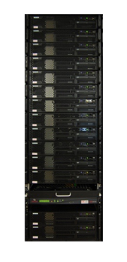
Intro To Alabama Supercomputer (ASC)
The ASC is a state-funded corporation that offers a High Performance Computing system for free to faculty, staff, and enrolled students of public schools, colleges, and universities in Alabama.
This system gives users to remotely access more memory, disk storage and processing capacity than what a PC can offer.
Offers a batch job submission system to allow for large scripts/ data processing to be run remotely rather than on the local PC.

Slide 6
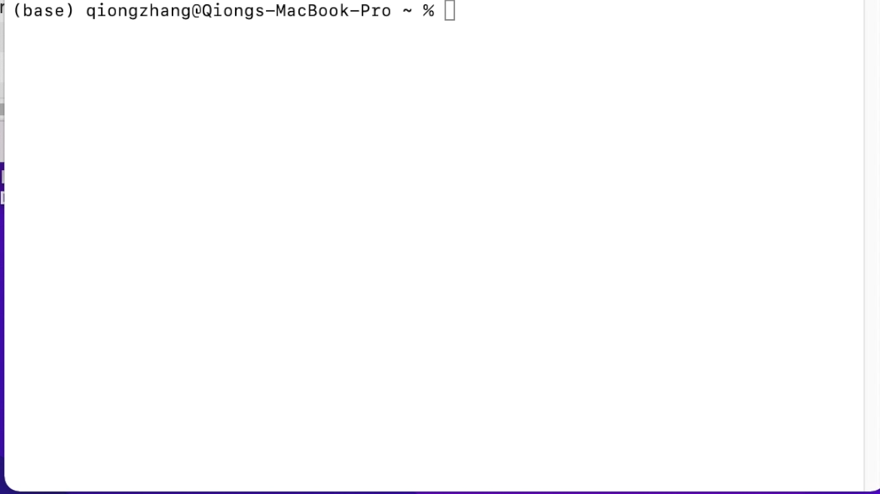
Intro To Alabama Supercomputer (ASC)
Request ASC account from
https://www.asc.edu/hpc/ASA-HP
C-Annual-Grant-Request-Form
Upload
$ scp your_local_path_of_files your_asc_account@dmc.asc.edu:~/path_of_the_directory_you_want_to_paste_into
Download files
$ scp your_asc_account@dmc.asc.edu:~/path_of_the_files_in_ASC path_of_dir_in_local
Notes:
The ASC is a state-funded corporation that offers a High Performance Computing system for free to faculty, staff, and enrolled students of public schools, colleges, and universities in Alabama.
This system gives users to remotely access more memory, disk storage and processing capacity than what a PC can offer.

Slide 7

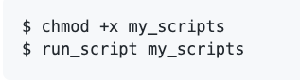
Submit jobs to Alabama Supercomputer (ASC)

Slide 8
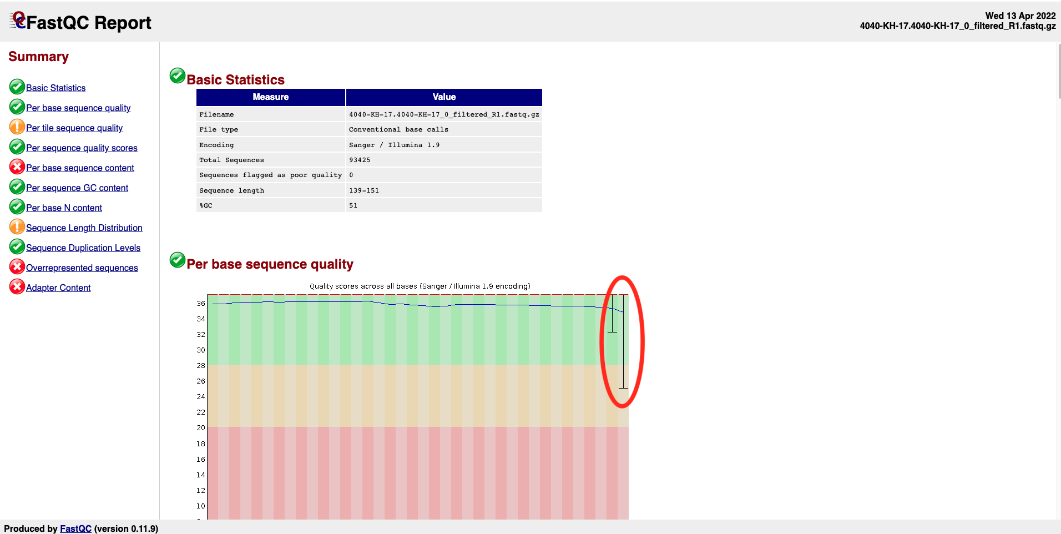
Step 1 - Run FASTQC on Raw Reads
Purpose: Used to check the read quality and adaptor sequence used
Function: FASTQC_raw
Module: FastQC
Input: *.fastq.gz
Output: *.html

Slide 9
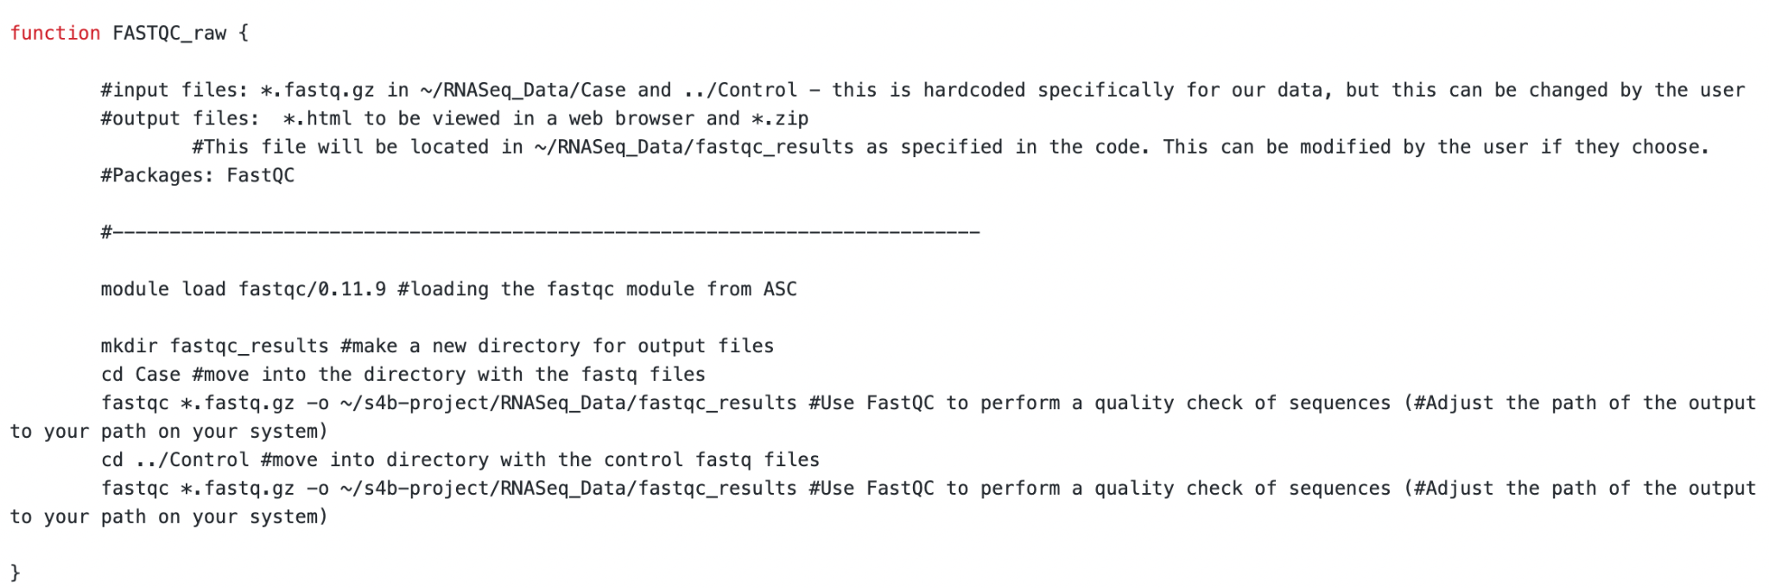

Slide 10
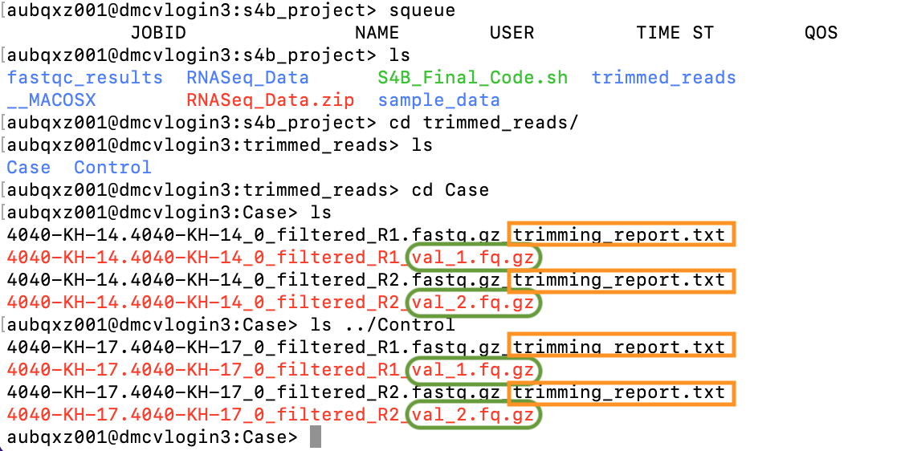
Step 2 - Trim Reads using TrimGalore!
Purpose: Used to check the read quality and adaptor sequence used
Function: trim_reads
Module: trimgalore
Input: *.fastq.gz
Output: *val_1or2.fq.gz

Slide 11
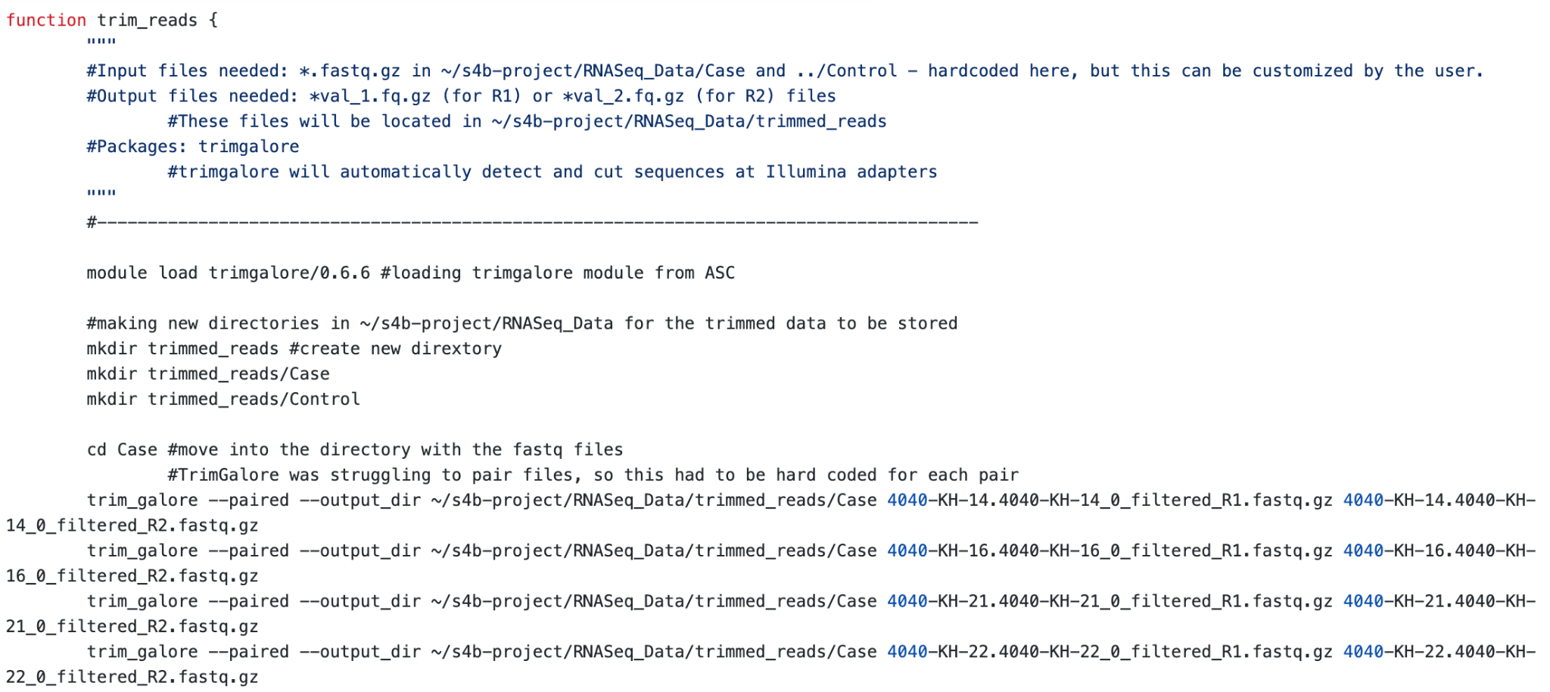
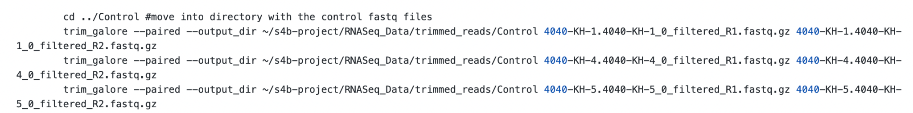

Slide 12
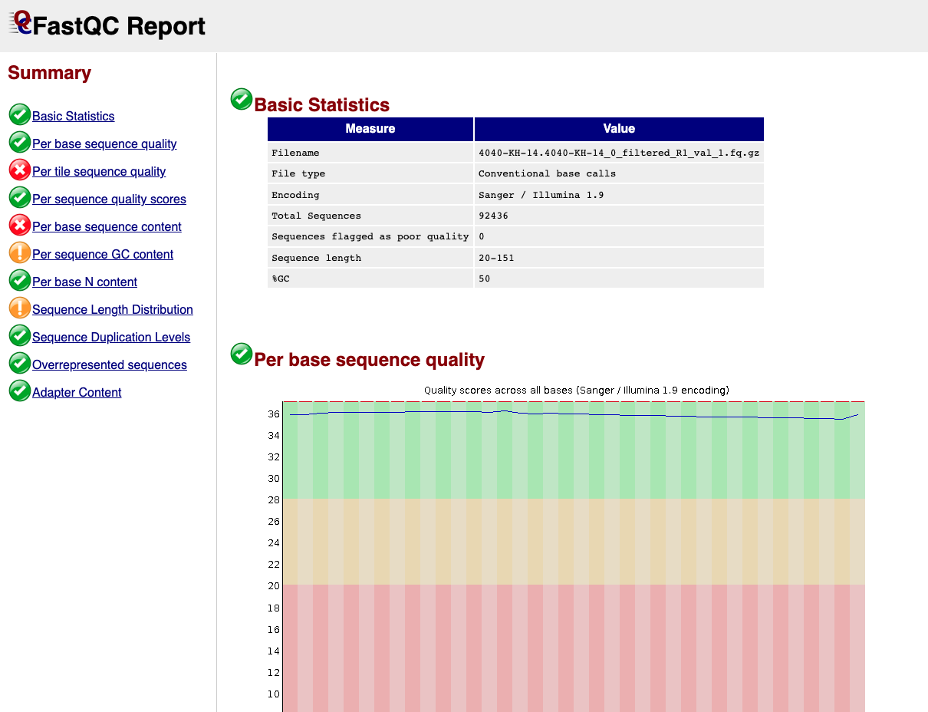
Step 3 - Run FASTQC on trimmed reads
Purpose: Used to check the read quality and adaptor sequence used
Function: FASTQC_raw
Module: FastQC
Input: *.fastq.gz
Output: *.html

Slide 13
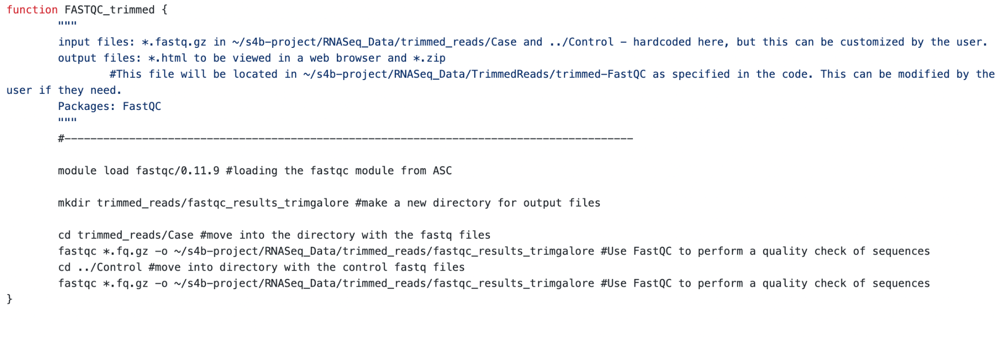

Slide 14
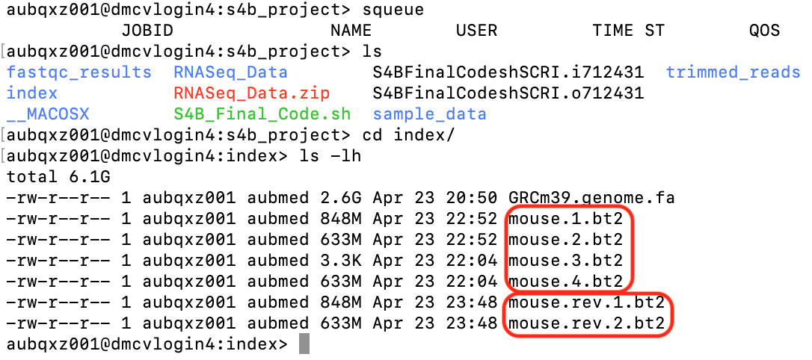
Step 4 - Index Reference Genome
Purpose: Allows aligner to narrow down the potential origin of a sequence within a genome. Speeds up alignment process
Function: INDEX_genome
Module: bowtie2
Input: GRCm39.genome.fa
Unzipped reference genome
Output: mouse.*.bt2

Slide 15
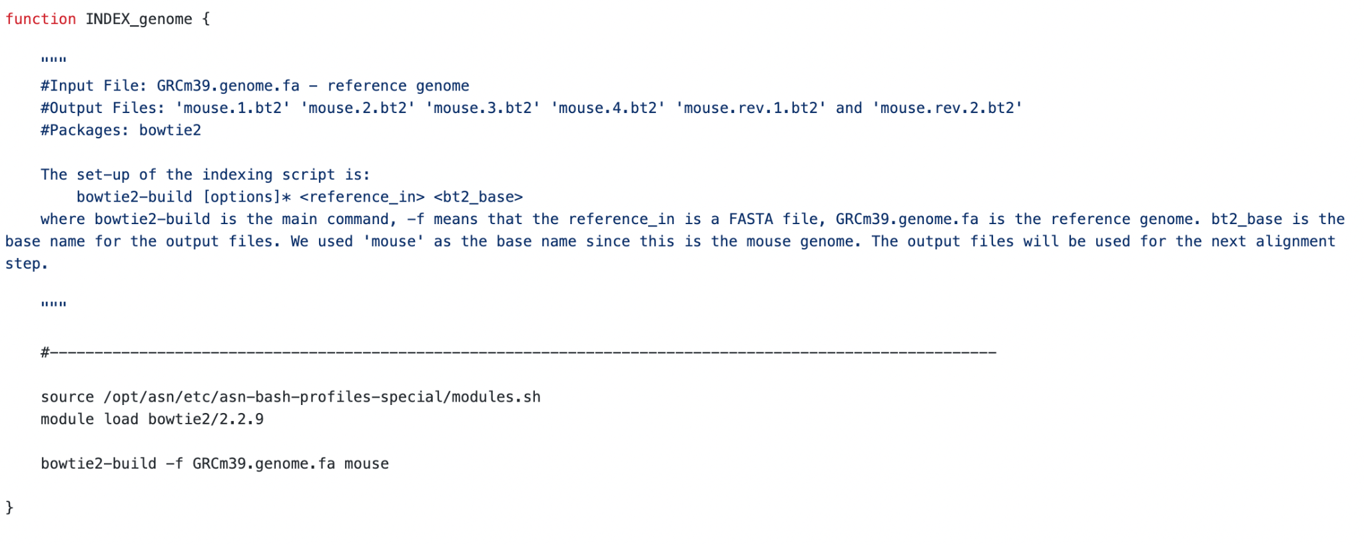

Slide 16
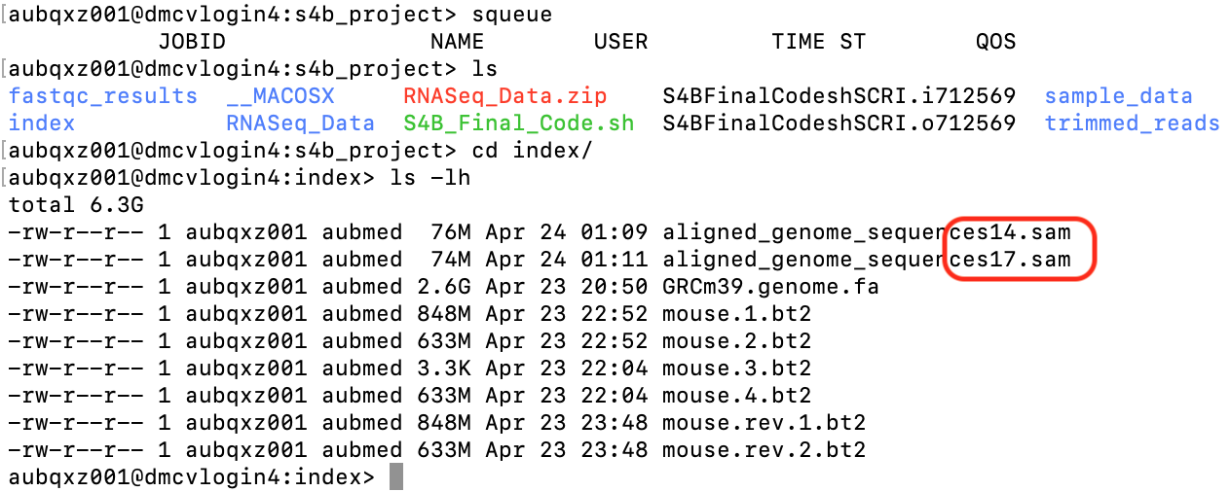
Step 5 - Align Reads to Indexed Genome
Purpose: align trimmed FASTQ files to the indexed genome
Input files: paired sample files *_1.fq and *_2.fq
Function name: Aligning_Reads
Output files: aligned_genome_sequence*.sam
Programs used: tophat2 & bowtie2

Slide 17
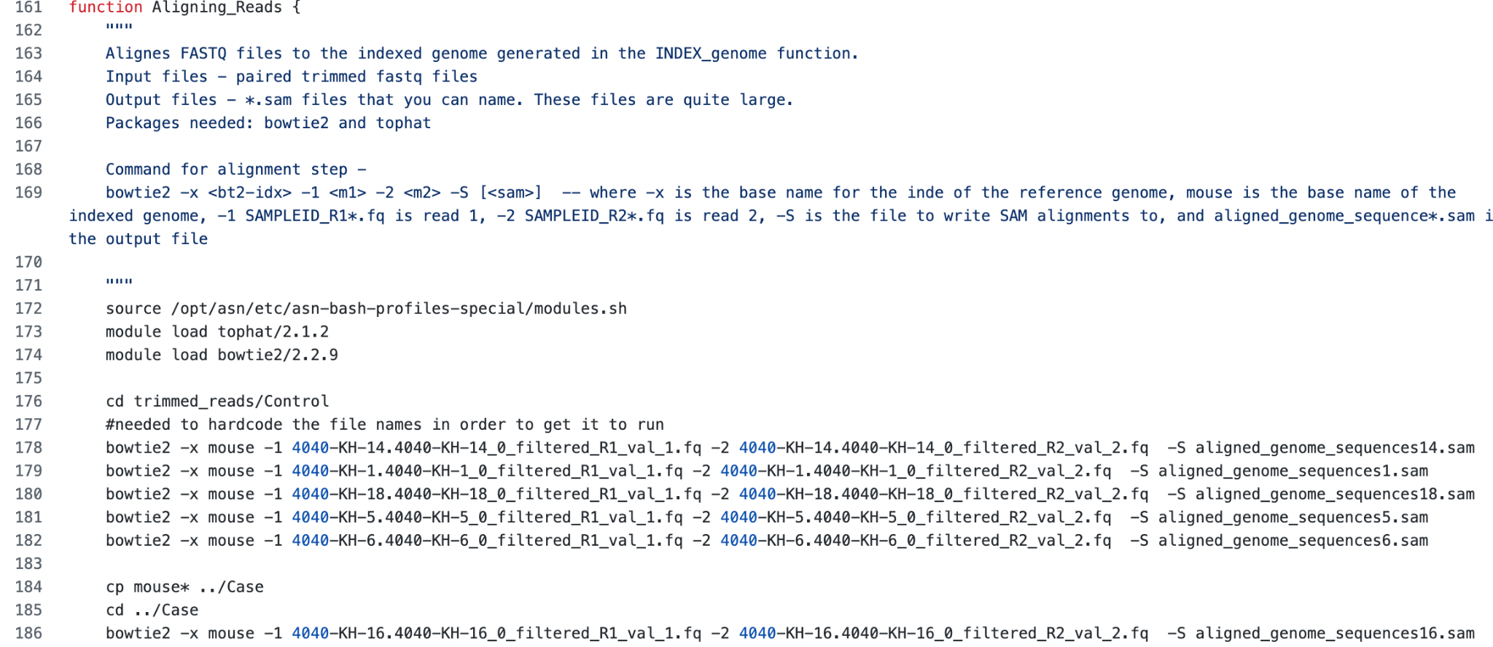

Slide 18
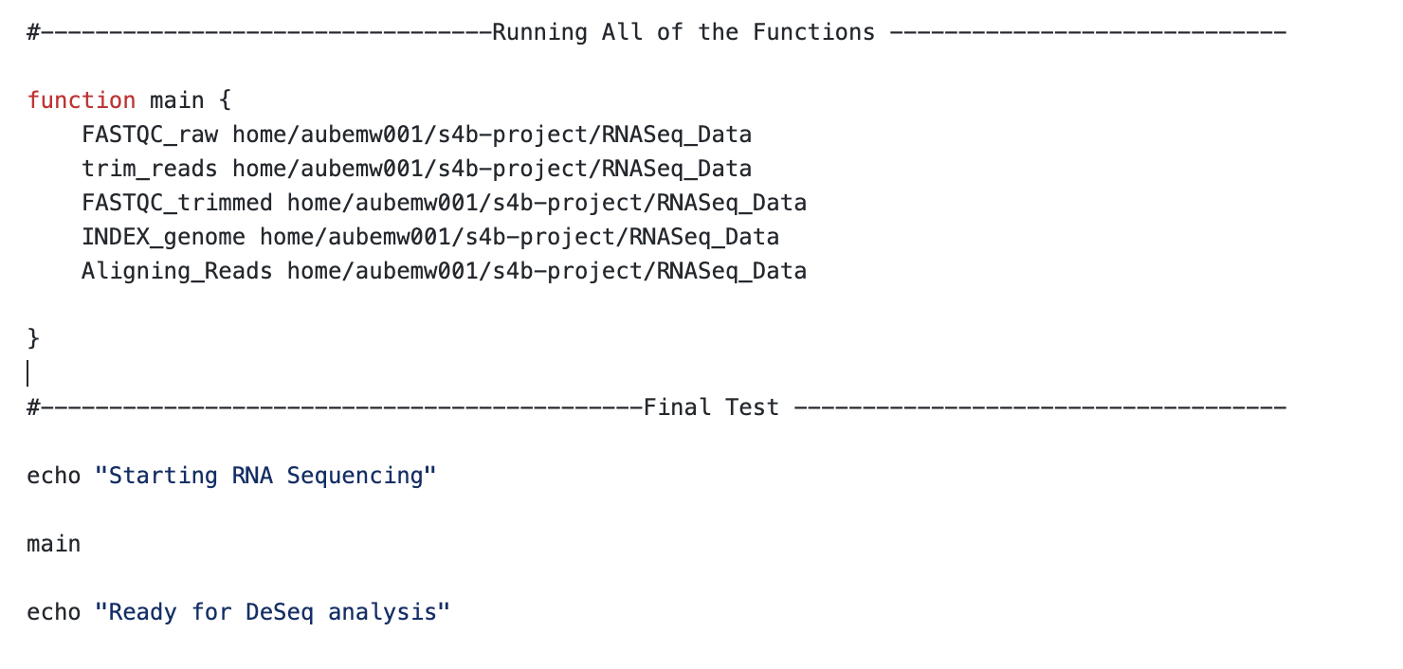
Final Test

Slide 19
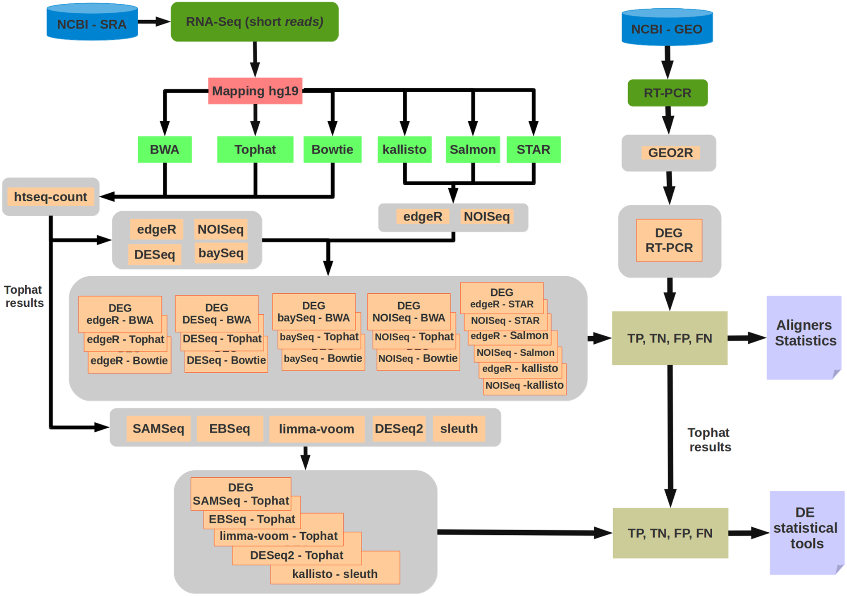
Future Directions
Assemble mapped reads into transcripts
Check for misalignments (htseq-count)
Differential gene analysis (DEG) - (DESeq)

